Slide 1
Sustainable coffee production under changing climatic conditions
Dr. Dave A. D‘haeze
C&C Workshop, Lam Dong
July, 2017

Slide 2
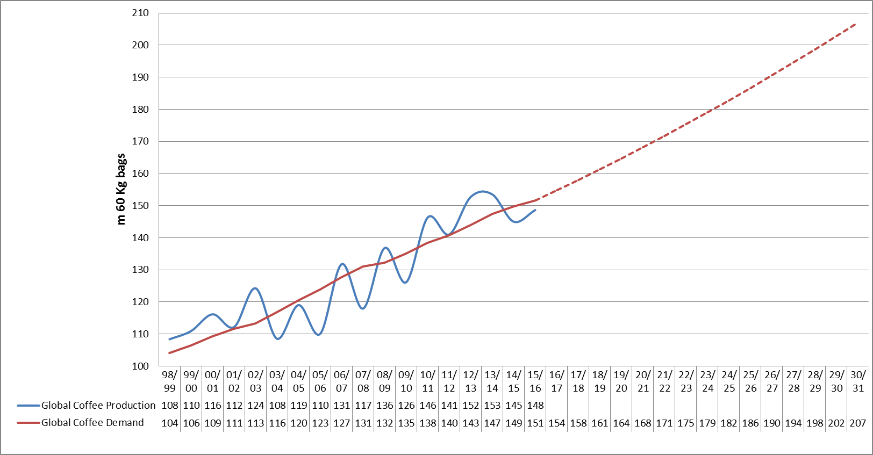
Global supply & demand trends
20 mio
38 mio
59 mio
Source: Neumann Kaffee Gruppe (2016)

Slide 3
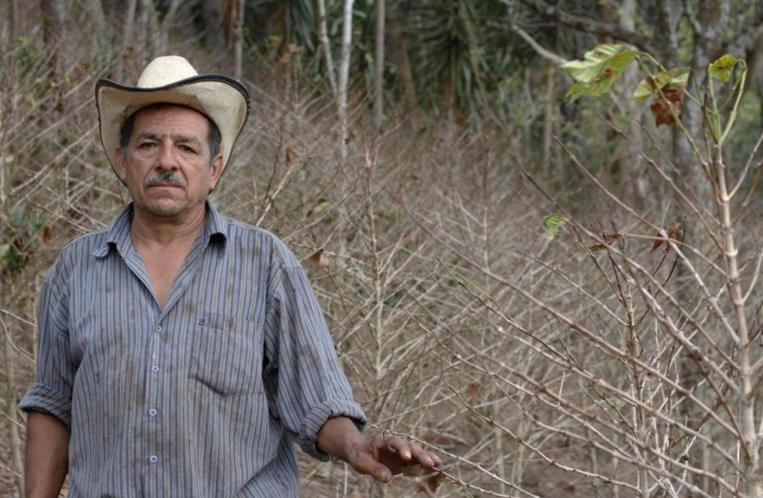
Effects of Climate Change - El Salvador, 14.01.2013
Could this have been avoided?

Slide 4
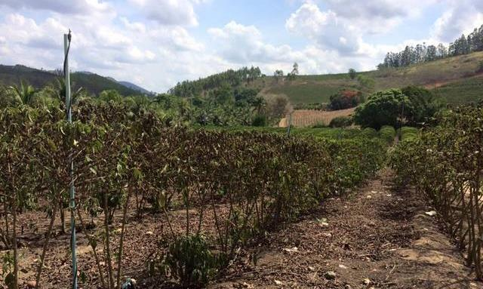
Effects of Climate Change - Brazil, 11.12.2015
Could this have been avoided?

Slide 5
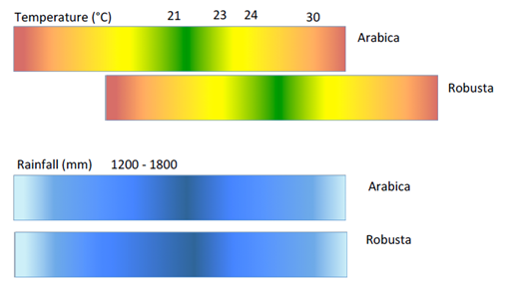
Coffee likes it cozy
Source: Future suitability of coffee in Uganda, IITA, CIAT, USAID, NARO, 5/2016

Slide 6
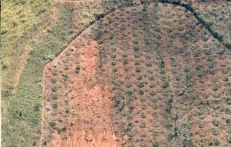
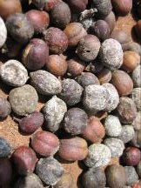
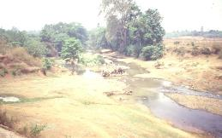
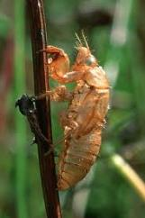
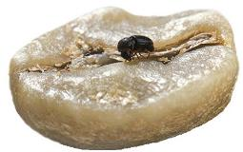
Vulnerability of Coffee Production
Income
Quality
Yield
Production Costs
Meta-bolism
Pests & Diseases
Soil
Temperature
Drought / Rain
Wind

Slide 7




Climate trends in Vietnam (1)
Climate variable | Tendency | Variation | Potential effect on coffee
Minimum temperature |  |  | Pest and disease increases
Max temperature
Diurnal temperature range |  |  | Pest and disease increases
Total annual rainfall |  |  | Increased variation makes planning farm work and coffee drying more difficult
Length of wet season
Heavy rain |  |  | Possible effects on flowering and tree damage

Slide 8
Climate trends in Vietnam (2)
Climate variable | Tendency | Variation | Potential effect on coffee
Continuous dry days (CDD)
Continuous wet days (CWD)
Outbreaks of wet weather in the dry season (ORD) | Mixed |  | Potential inhibition of pollination after flowering
1-week Palmer drought severity index
Other drought severity indices | Mixed

Slide 9
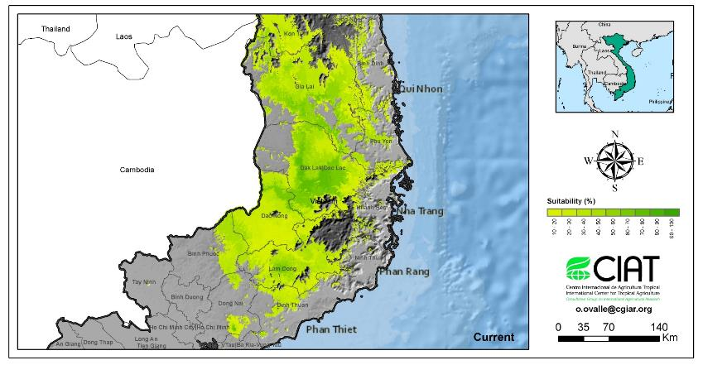
Vietnam: Land Suitability Predictions - Current

Slide 10
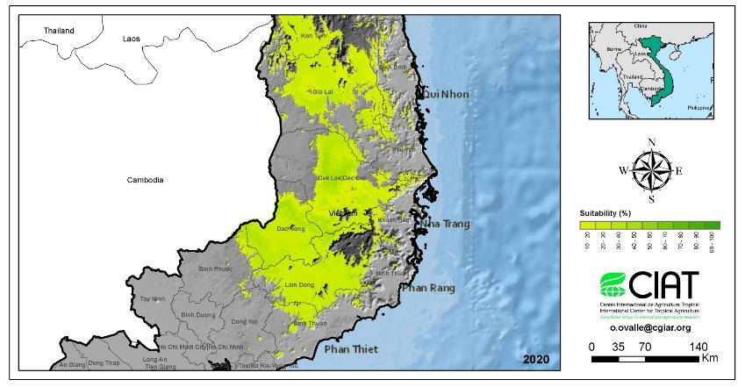
Vietnam: Land Suitability Predictions - 2020
Notes:
In Viet Nam the mean annual and the minimum and maximum monthly temperature will increase by 2020 and continue to increase by 2050. The annual precipitation in contrary will decrease by 2020 but increase by 2050.The overall climate will become more seasonal in terms of variation in temperature through the year with temperature in specific districts increasing by about 0.7 ºC by 2020 and 1.8 ºC by 2050 and more seasonal in precipitation with the maximum number of cumulative dry months decreasing from 5 months to 4 months.

Slide 11
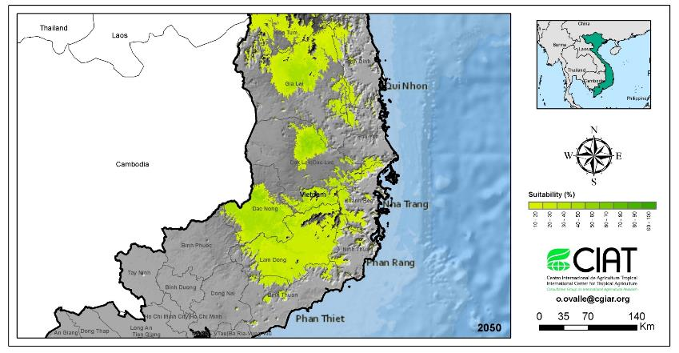
Vietnam: Land Suitability Predictions - 2050
Optimum producing zone will increase by 2050 to altitude 600 - 1000m asl (currently 300 - 900m asl)
Notes:
There will be areas with a slight loss in suitability for coffee (Lam Dong, DakNong), but may remain suitable if farmers adapt their agronomic management to the new conditions the area will experience. In Viet Nam only few areas present a slight increase in suitability, these are located in Dak Nong, Lam Dong and on the frontier of the latter with Dak Lak. Finally, there will be areas where currently no coffee is grown but which in the future will become suitable especially in higher altitudes around the Central Highlands, where important natural reserves are located, such as: Bi Dup-Nui Ba, Rung Thong Da Lat and Kalon Song Mao

Slide 12

Supply chain risks
Farmer
Processor
Exporter
Trader
Roaster
Natural Resources
Yield
Production costs
Quality
Market volatility
Income/Livelihood
Motivation
What to do?
Availability
Price
Blend
Investment Risk
Reputation
Notes:
How to protect ressources?
How to utilize ressources best?
What investments to take?
What are cost/benefit implications?
How to optimize income
How to stabilize availability and quality?
How to reduce price volatility?
How to improve planning and limit costs?
How to contribute to improve services to producers and how to use ressources best?

Slide 13

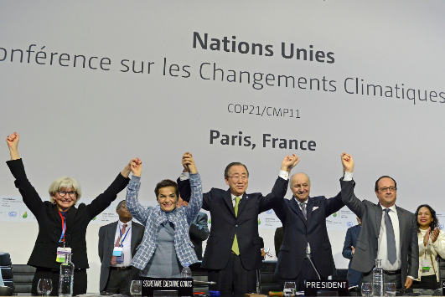
Paris Agreement
Objectives
Keep global temperature rise below 2 degrees Celsius above pre-industrial levels
Pursue efforts to limit temperature increase even further to 1.5 degrees Celsius

Slide 14
The importance of coffee
Coffee production in 70 countries
100 million people involved
70% smallholders
90% produced in developing countries
Pioneer activies showcase the potential (productivity; mitigation; adaptation)
Climate-smart production is the way forward
Notes:
Emphasizing on the importance of coffee: 70 countries, 100 million people in production and coffee value chain, 70% smallholders, 90% of produce from developing countries.
Millions of farmers and actors along the supply chain can become affected by climate change (suitable area can decrease; further production challenges; livelihood concepts endangered).
Within c&c companies and organizations have started to respond to risks and threats.
Partners consolidate experiences and cooperate for upscaling successful approaches.
There are pioneer activies with important learnings (coffee NAMA in Costa Rica; c&c pilots; SBUX long-term cooperation with Conservation International; the experiences of the FNC in Colombia, the Brazilian Coffee Research, World Coffee Research etc.).
There is a wish to join the global efforts to effectively address climate change and strengthen farmer resilience; the coffee sector has large potential to contribute to mitigation GHG in the land-use sector.
Climate smart production ensures food security and provides income, while enhancing climate resilience and contributing to socially responsible land use practices.
Diversified coffee production can help stabilizing ecosystems and landscapes, and enhance biodiversity.
The coffee sector can assume a leadership role promoting sustainable land use practices for a wide range of commodity crops.

Slide 15
Intended Nationally Determined Contributions (INDC)
Coffee-producing countries that mention mitigation and/or adaptation in agriculture in submitted INDCs
Adaptation | Yes | Ecuador, India, Papua New Guinea, Philippines, Tanzania, Thailand | Bolivia, Burundi, Cameroon, Colombia, DR Congo, Costa Rica, Côte d'Ivoire, Cuba, Dom. Rep., El Salvador, Ethiopia, Guatemala, Guinea, Haiti, Honduras, Indonesia, Kenya, Laos, Madagascar, Mexico, Peru, Rwanda, Togo, Uganda, Vietnam, Yemen
 | No | Nicaragua, Panama, Venezuela | Brazil
 |  | No | Yes
 |  | Mitigation
Mentioned adaptation & mitigation
(Yes-Yes)
Eight countries mentioned the
coffee sector in their INDC submissions (see countries in bold lettering on left), representing 34% of coffee production.
Sources: UNFCCC, WRI, ICO, CGIAR, Hortensia Solis analysis. Note: Nicaragua, Panama and Venezuela had not submitted INDCs by 28 Nov. * Total coffee production in 2014: 143,000 bags of 60 Kg.`

Slide 16








C&C - Statement
“Mitigation and adaptation to climate change –
voluntary contributions of the coffee sector”
>
50 % of global coffee business

Slide 17
C&C - Position
C&C appeals governments and relevant institutions
  to support low-carbon and climate-resilient solutions
  to enhance capabilities of coffee-farmers to deal with climate change
  to cooperate in partnerships that implement relevant and concrete projects in coffee-growing regions
  to help raising awareness for appropriately valuing climate-smart solutions for coffee production and sustainable land use
Notes:
We envisage to:
raise interest for our sector
achieve better support for farmers
align our efforts and raising efficiency
We offer to governments and donors to accompany us in our efforts and leverage our commitments.
We invite other companies and sector stakeholders to join in and contribute to combat climate change.
We also invite to join us in c&c and help further developing our sector knowledge and upgrading our approaches to the benefit of coffee farmers world wide.

Slide 18
C&C - Vision & Mission
Vision
Enable coffee farmers to effectively respond to climate change
Mission
Combine state of the art climate change science and proven farming methods
Offer practical, hands-on and applicable tools
Form a network of all relevant stakeholders in the field
Apply a precompetitive approach including the entire value chain

Slide 19
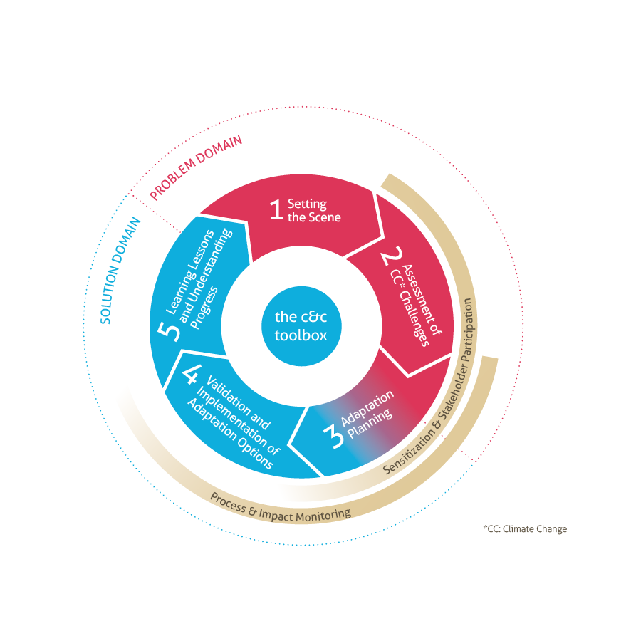
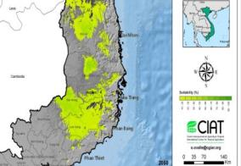
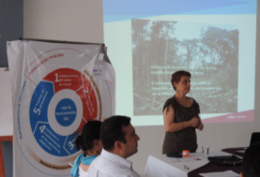
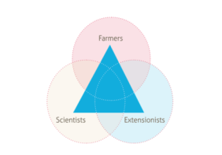
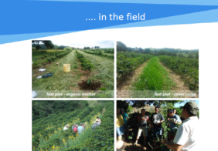
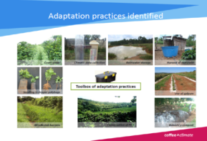
C&C - Approach
Notes:
A participatory approach able to develop and implement location specific solutions to addressing climate change.

Slide 20
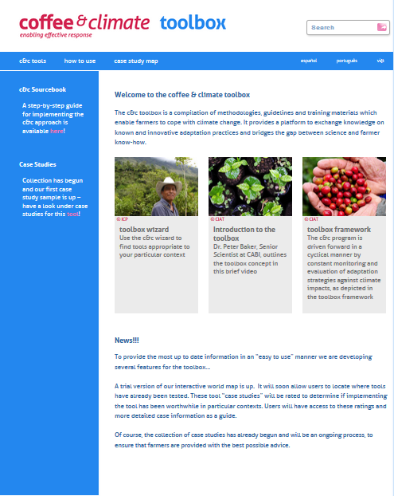
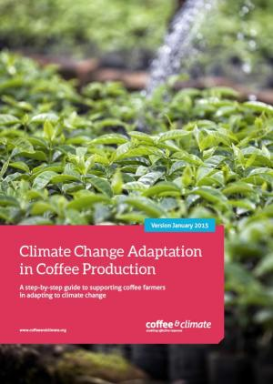
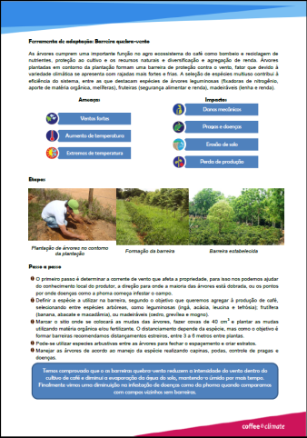
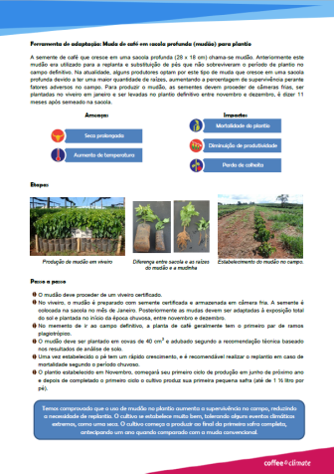
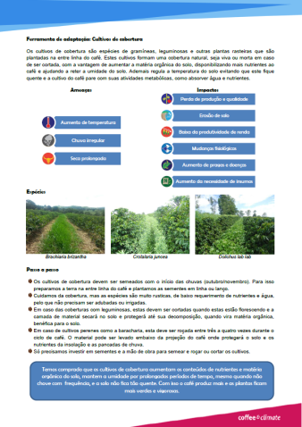
Documentation and knowledge management
Notes:
Products developed within phase I. They provide the basis for further knowledge generation and management during phase II.

Slide 21
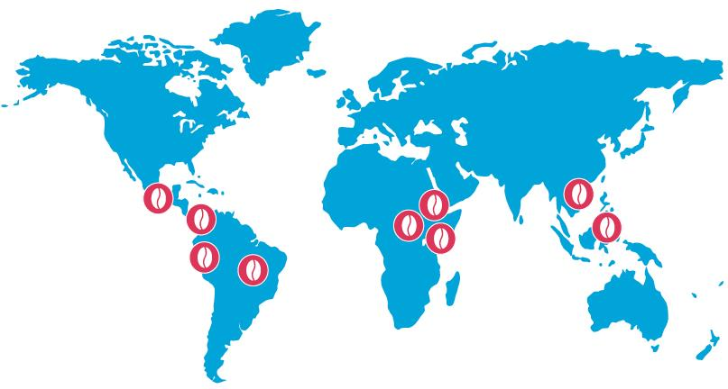
Towards a sector initiative
Further develop-ment of approach
Scaling
Institutionalization
phase II: 2016 –2019
70.000 farmers
Notes:
c&c has the opportunity of becoming the sector initiative for addressing climate change.
Focus areas of phase II:
Further development of the c&c approach by identifying and documenting additional adaptation options and towards incorporting community-based adaptation, ecosystem-based adaptation and mitigation.
Scaling and reaching at least 70,000 farmers within current c&c pilot regions and neighbouring countries by qualifying and enabling other implementing structures to make use of the c&c approach (through providing training of trainers, coaching, backstopping and joint acquisition of additional funding); connecting c&c with the UNFCCC process and country-specific coping strategies for addressing climate change (NAMAs and NAPAs).
Institutionalization of c&c as a long-term format in the coffee sector for assuring in particular the knowledge management of c&c and the dissemination of the approach sector-wide.

Slide 22
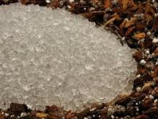
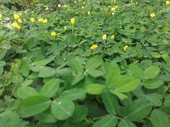
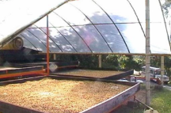

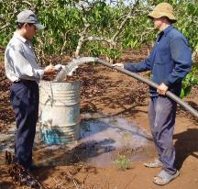
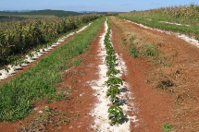
Adaptation Priorities Identified in Vietnam
  (no regret) measures (short-term)
  → Ground cover
  → More efficient irrigation
  Experiment with (mid-term)
  → Centralized drying
  → Drip irrigation
  → Application of hydro-polymers
  → Crop diversification and shade trees
  Collect more data (long-term)
      Metereological
      Groundwater levels
      Pests (cicadas)

Slide 23
Adoption rates after 2 years
Source: Farmer field book data 2013 and 2014
Notes:
Many farmers adopted more than one adaptation option.

Slide 24
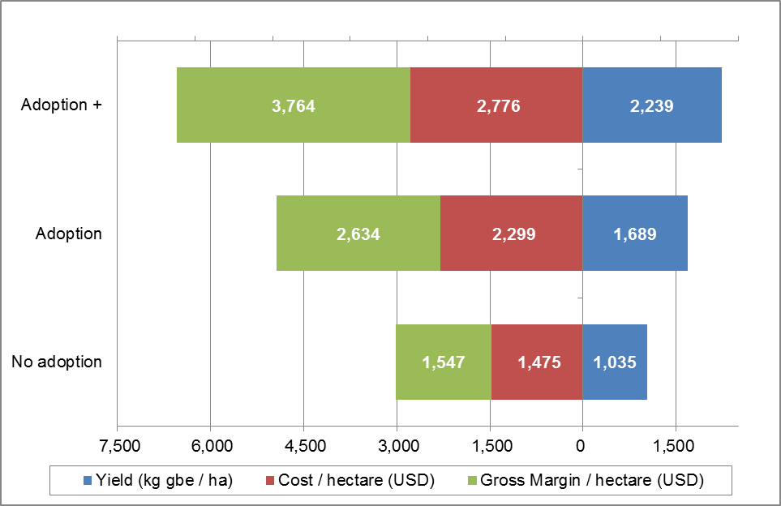
Adaptation pays
Source: Farmer field book data 2013/2014
Notes:
Bags/ha yield kg/ha costs R$/ha costs R$/bag
37,37 2239 2776 74,39
28,15 1689 2299 81,67
17,25 1035 1475 85,51

Slide 25
dave.dhaeze@ede-consulting.com www.coffeeandclimate.org
Let’s adapt to Climate Change TOGETHER

